Slide 1
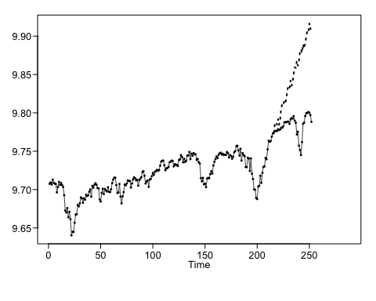
Question 1
Which model do you think is appropriate to use to forecast your time series? Why? Add this to the Google Doc as well as to your PowerPoint deck.
The model that seems most appropriate would be an airline model, with a 1-B trend component if the appropriate phi values can be found.
library(tswge) data(dowjones2014) plotts.wge(dowjones2014)
fore.aruma.wge(dlog,s=12,phi=c(-.36,-.05,-.14-.11,.04,.09,-.02,.02,.17,.03,-.1,-.38),d=1,n.ahead=36,lastn = TRUE,plot=TRUE,limits = FALSE)

Slide 2
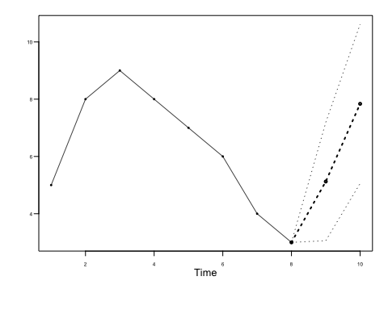
Question 2
Find the first 5 psi weights for the model below, and use them to find the half-width of the 95 percentile probability interval for the third forecast (Xhat(3)). Please show your work as well as a plot of the series and the first eight forecasts with probability intervals.
w = psi.weights.wge(phi=c(.9,-.8),lag.max=5)
psi weights = 0.9, 0.01, -0.711, -0.6479, -0.01431
data = c(5,8,9,8,7,6,4,3) fore.arma.wge(data,phi=c(.9,-.8),plot=TRUE,limits = TRUE)

Slide 3
Thoughts
It seems to me that predictive models that are gauged as to their effectiveness with ASE fail to consider that the model is simply overfitting the data.

